Slide 1
Java Login System Development
SUBHASH KANITHI
Company: SNSINFOTECH Innovations Pvt Ltd

Slide 2
Introduction to Login System
Objective: To design and develop a visually appealing and functional login page using Java.
Core Functionality:
Secure user authentication against a backend database.
Real-time validation and feedback (Success/Error messages).
Clean and professional UI/UX design.

Slide 3
Tools & Technologies Used
To meet the project requirements, the following stack was utilized:
Frontend: HTML5, CSS3 (for styling and alignment), and JavaScript (Optional toggle feature).
Backend: Java Development Kit (JDK).
Server: Apache Tomcat.
Database: MySQL (for storing user credentials).
Connectivity: JDBC (Java Database Connectivity).

Slide 4
Application Flow Diagram
Process Step-by-Step:
User Input: User enters UserID/Email and Password into the frontend.
Java Processing: The backend captures input and initiates a database connection.
Database Check: A SQL query verifies if the credentials exist in the Users table.
Response: The system returns a success redirect or an error message based on the match.

Slide 5
Database Structure
The backend relies on a structured MySQL table to manage authentication:
Database Name: Logindb
Schema:
Field | Type | Description
id | INT | Primary Key (Auto-increment)
userId | VARCHAR | Unique Identifier / Email
password | VARCHAR | Encrypted or Plaintext password

Slide 6
Code Explanation and Implementation
Frontend: Focused on proper alignment and clean layout using CSS flexbox/grid.
Backend Logic: * Used HttpServletRequest to capture parameters.
Implemented a try-catch block for robust error handling and database connectivity.
Security: Implemented basic validation to ensure fields are not empty before submission.

Slide 7
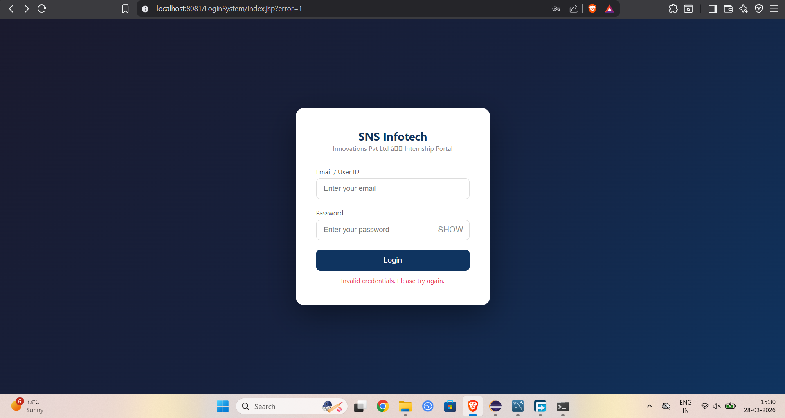
Application Demo
1. User Interface: Login Page

Slide 8
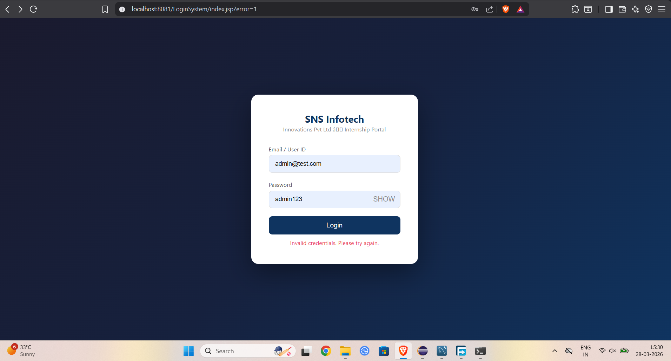
Authentication Success: User Dashboard

Slide 9
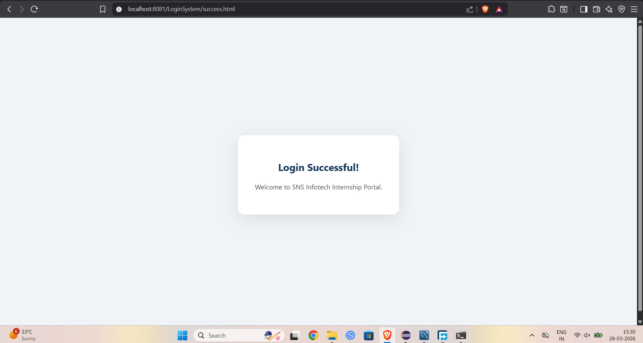
Redirect page after entering valid credentials :

Slide 10

Error Handling: Invalid Credentials

Slide 11
Key Learnings & Conclusion
Technical Skills: Gained hands-on experience in connecting Java applications with MySQL via JDBC.
UI/UX: Learned the importance of layout alignment and user feedback in web forms.
Full-Stack Workflow: Developed a deeper understanding of how data flows from a browser to a server and finally to a persistent database.

